Slide 1
Neuroscience Basis

Slide 2
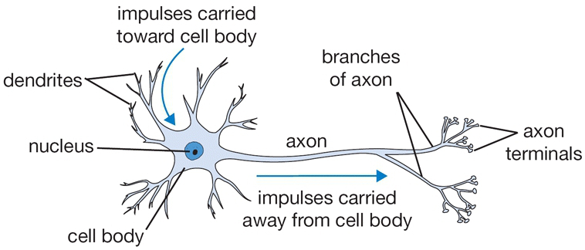
Neuron Schematic

Slide 3
Connectionism Theory
Learning occurs through changes in the connections between neurons
Complex behaviors emerge from the interactions between massive numbers of highly interconnected neurons
Influence on some components of deep learning architectures / algorithms
Many unknowns / significant gaps remain (for both living and artificial brains)

Slide 4
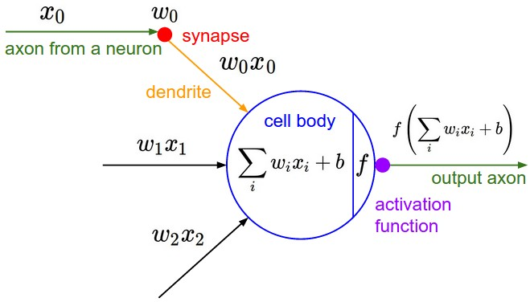
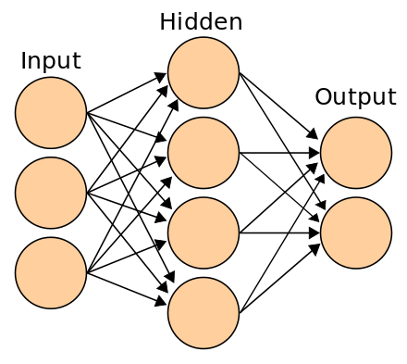
Influence on Deep Learning

